Slide 1
Amazon Recommender System
Kyla Ronellenfitsch, Rash Pal, Chris Nakamura, Jenny Jiang, Jaclyn Ivanisevic

Slide 2
Agenda
Business Case
Data and Insights
Segment Identification
Modeling
Conclusion

Slide 3
Business Case

Slide 4
Introduction to Recommendation Systems
Recommendation systems identify similarities between users and items and exploit that information to make recommendations
Benefits:
Assists users to find right products
For a business, it can increase user engagement
Allows producers to meet the right consumers
Makes the content more personalized for each user
Notes:
Example, google 40% more clicks due to recommendations.
Example, Amazon sells about 35% of its products due to recommendations
Netflix personalized recommendations

Slide 5
Types of Recommendation Systems
Content-Based
Collaborative Filtering
Hybrid Approach
recommends items based on items similar to user’s past interactions
based on the assumption that people continue to like similar things
combines collaborative and content-based filtering
Classification-Based
Popularity-Based
Association Rule Mining
understands the features of the user and classifies
recommends items viewed and rated by most people
captures relationship between items based on their patterns of co-occurrence across transactions
Notes:
We need to change the description for content based

Slide 6
Business Problem: Collaborative Filtering
Amazon uses a Collaborative Recommendation System. There are two key challenges with this approach:
Gray Sheep are those whose opinions or behaviours are inconsistent and thus do not benefit from collaborative filtering. Similarly, Black Sheep are nearly impossible to classify due to their atypical tastes.
Cold Start users are new customers who have had little or no interaction with the system and are not possible to provide personalized recommendations for.

Slide 7
Data & Insights

Slide 8
Data
Amazon Luxury Beauty Product Reviews
Used a subset of data which included only reviewers with at least five reviews
34k rows, 12 columns
Features:
Reviewer ID
Product ID
Overall rating: 1-5 stars
Review text (unstructured)
Summary: Summary of the review text (unstructured)
Luxury Beauty Product Metadata
Data set containing information on each product
Features:
Product ID
Title (unstructured)
Description (unstructured)
Price

Slide 9
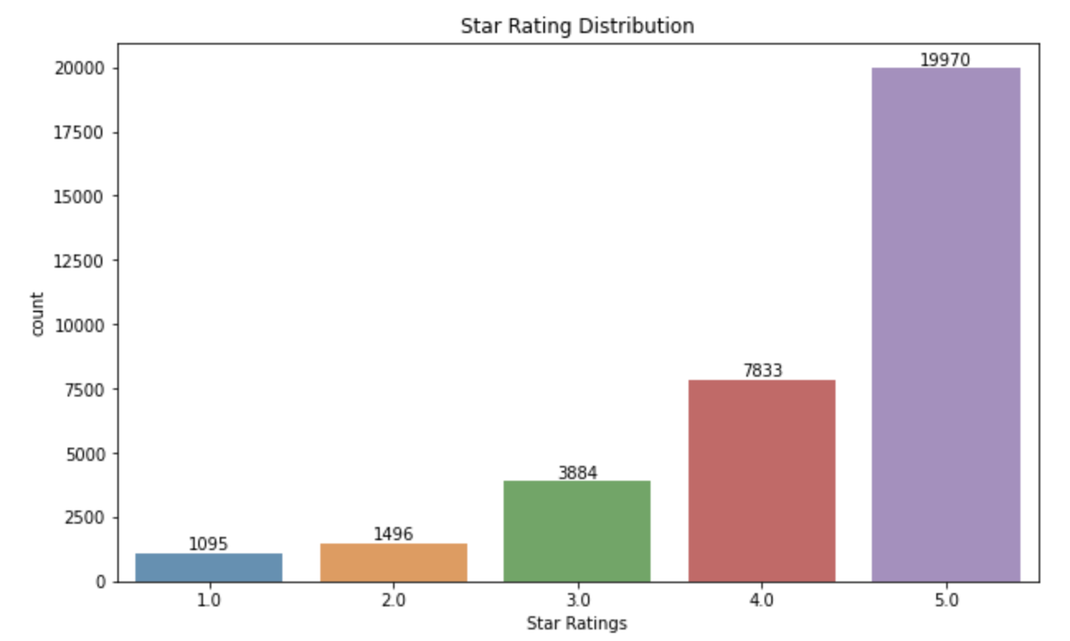
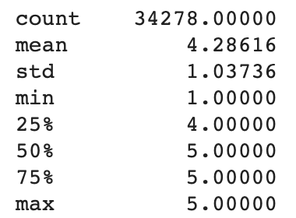
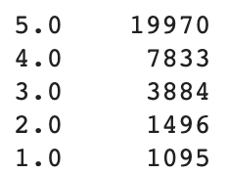
Data Insight - Product Ratings
Notes:
Should this go up by the dataset slides?

Slide 10
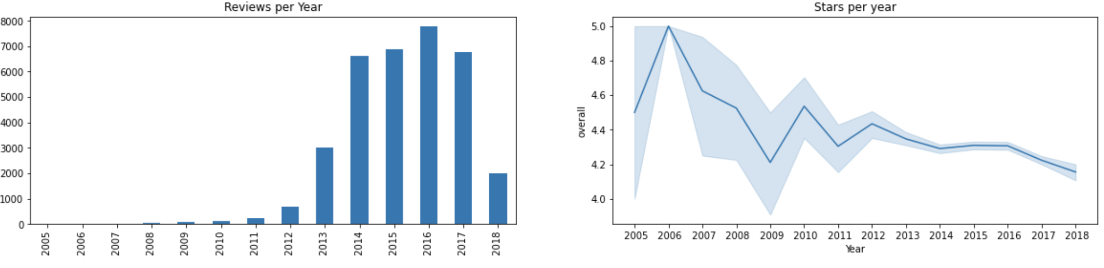
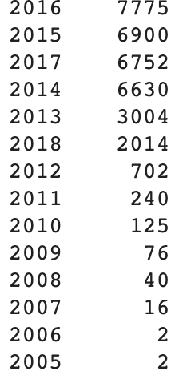
Data Insight - Reviews & Rating by Year
Notes:
Should these go up by the dataset slides?

Slide 11
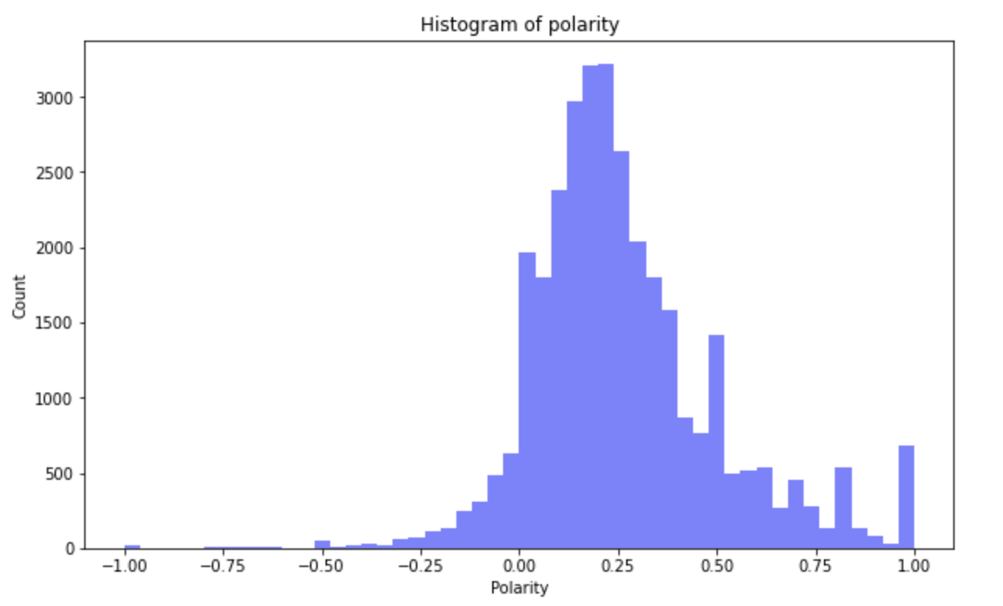
Sentiment Analysis on Product Reviews

Slide 12
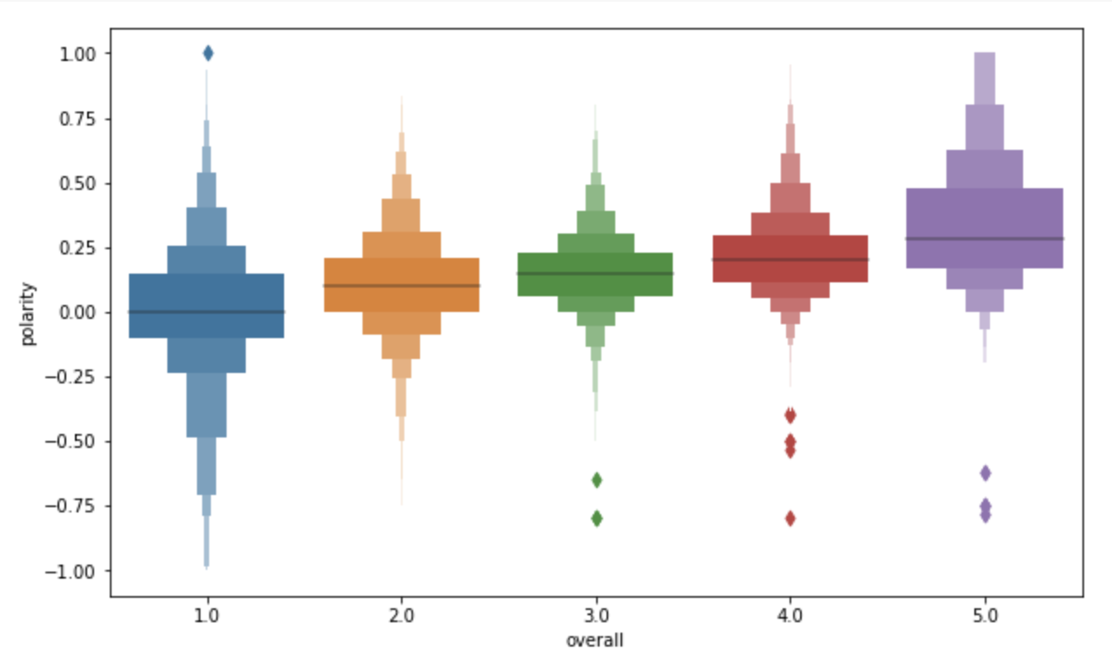
Review Sentiment Based on Rating

Slide 13
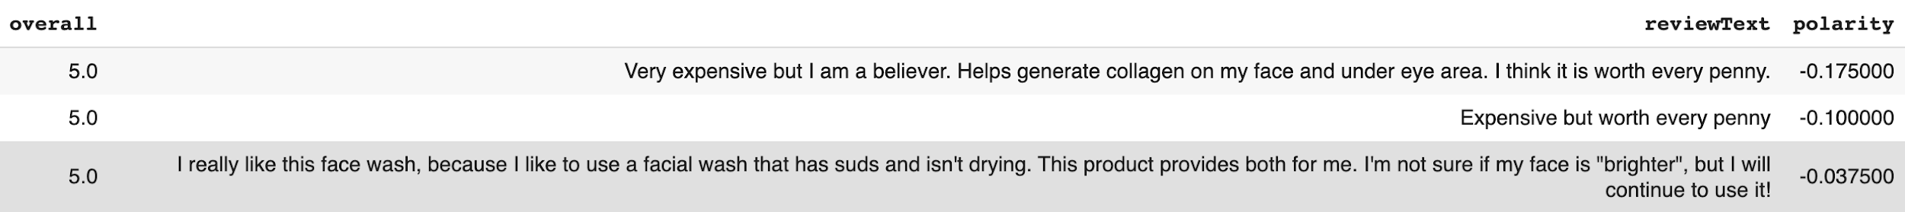
Review Sentiment - Outliers
Negative Polarity with highest rating
Positive Polarity with lowest rating

Slide 14
Product Segmentation
1
2
3
4
Predefine 7 categories for all beauty products
Use word2vec to convert words to vectors
Extract nouns from all product title
Use word2vec to convert those nouns to vectors
Calculate similarity score between categories and extracted nouns
Pick top 15 extracted nouns that have the highest similarity score in each category
Loop over each product to calculate a frequency score for each category
Choose the category with the highest frequency score as final category for each product

Slide 15
Example
Seven Categories
Makeup
makeup, eyeliner, eyeshadow, lipliner, manicure ...
Skin care
skin, pigmentation, blackhead, redness, moisturizing ...
Hair care
hair, beard, blowdry, frizz, shampoo...
Fragrance
fragrance, perfume, cologne, scent, bodycare ...
Hand care
hand, finger, palm, side, glove ...
Nail care
nail, seal, polish, polishing, scalp ...
Oral care
tooth, lip, cuticle, gum, toothbrush ....
PCA SKIN C-Quench Antioxidant Serum
SKIN
Serum
Category - Skin care: 1
Final category - Skin care
Notes:
Should these go up by the dataset slides?

Slide 16
Aspect-based Sentiment Analysis
1
2
3
4
Predefine aspects for one category
Use word2vec to convert words to vectors
Extract nouns from all customer reviews in that category
Use word2vec to convert those nouns to vectors
Calculate similarity score between aspects and extracted nouns
Pick top 15 extracted nouns that have the highest similarity score for each aspects
Loop over reviews of each product to calculate a sentiment score for each aspect
Notes:
Need to address:
Why choose noun?

Slide 17
Example
Take skin care category as an example
Price
price, pricing, cost, discount, purchase ...
Moisture
moisture, moist, humidity, wetness, dampness ...
Scent
scent, aroma, smell, fragrance, odor ...
Ingredient
ingredient, element, component, additive ....
Love this item. It calms my skin. The smell is good, but I don’t like its price
item, skin, smell, price
smell in Scent aspect
price in Price aspect
Aspect - Scent: 1
Aspect - Price: -1
Notes:
Should these go up by the dataset slides?

Slide 18
Segment Identification:
Black Sheep & Cold Starts

Slide 19
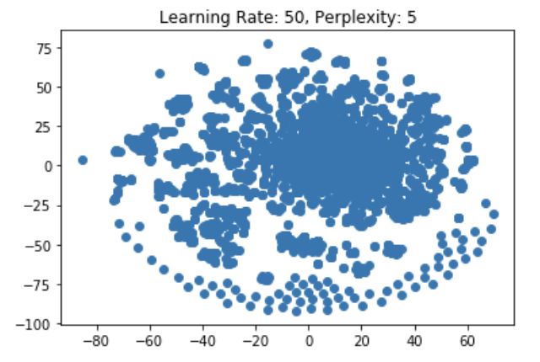
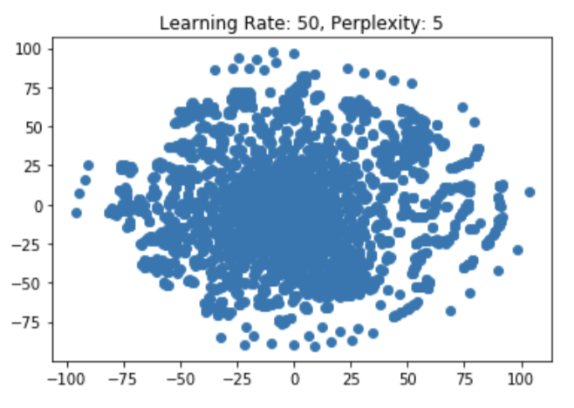
5 Star Ratings vs. Sentiment
TSNE: 5 Star Ratings
TSNE: Sentiment Score

Slide 20
Clustering
 | Cluster: 5 Star | n= | Cluster: Sentiment | n=
K-Means | 0 | 3434 | 0 | 3574
 | 1 | 385 | 1 | 245
DBSCAN | -1 | 113 | -1 | 229
 | 0 | 3706 | 0 | 3590
Hierarchical | 1 | 384 | 1 | 323
 | 2 | 276 | 2 | 3496
 | 3 | 3159

Slide 21
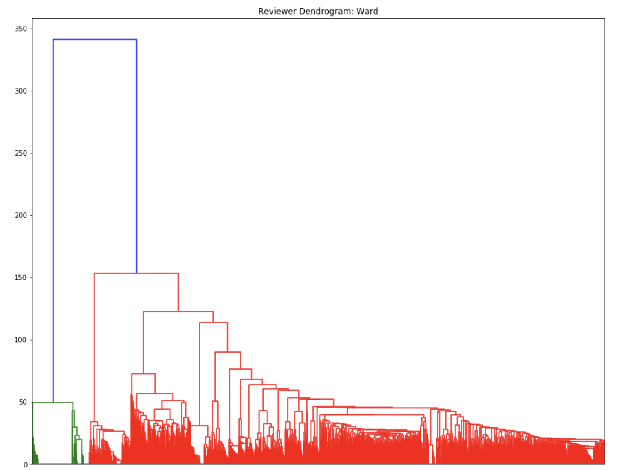
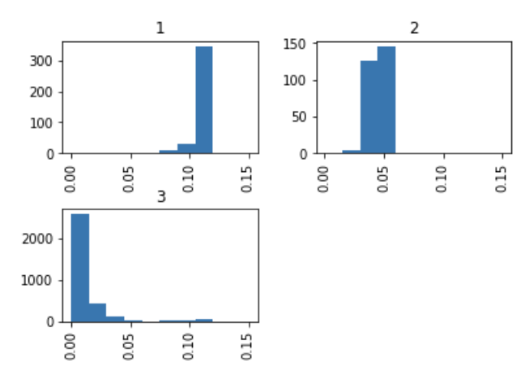
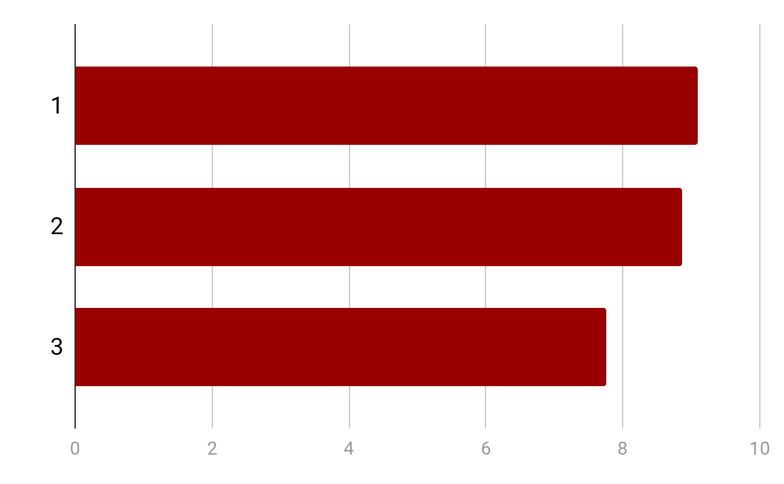
Hierarchical Clusters
Dendrogram
Average Cosine Similarity
Average Products Purchased

Slide 22
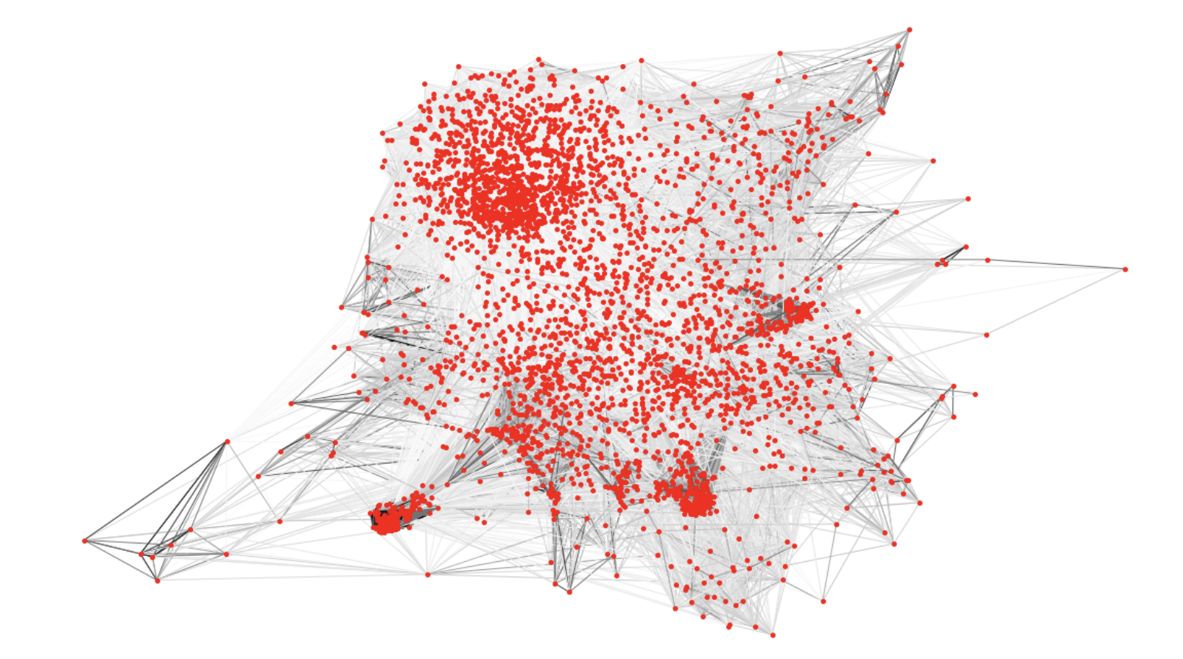
Customer Network
Network analysis using cosine similarity as weights for adjacency matrix

Slide 23
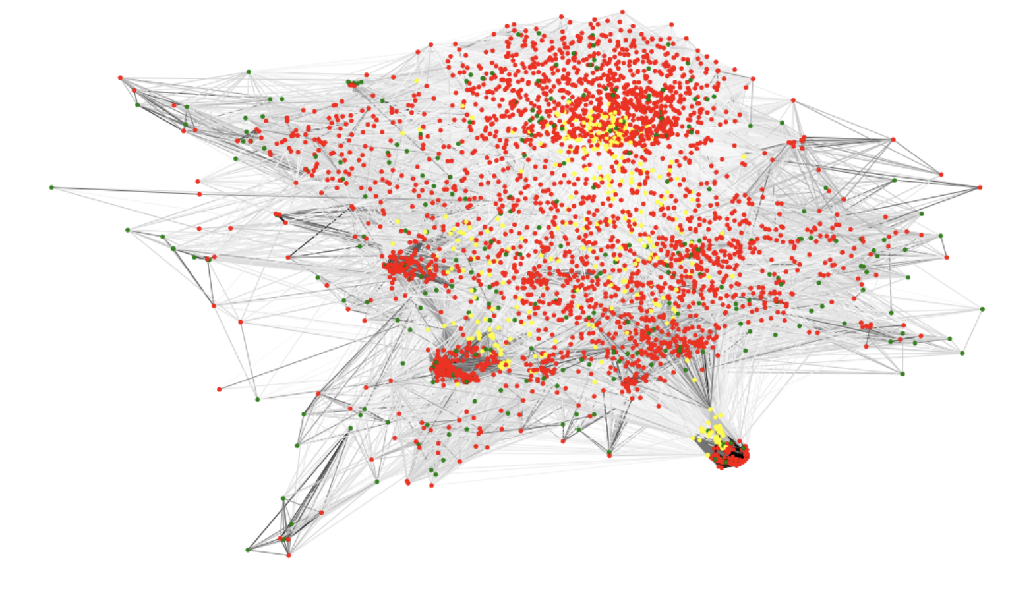
Segment
Identification
Cold Start: <= 40 degrees
Gray Sheep: >= 90th percentile Betweenness Centrality
Typical Customer: Remaining customers

Slide 24
Modeling

Slide 25
Content Based Recommendation
Model Construction & Results
Recommendations based solely on item information
Construct a similarity matrix of items based on cosine similarity of the vectorized words in the metadata title and description
For an instance of a purchase by a customer, compute the most similar items to the item purchased
Precision at 5 is a calculation the portion of the top 5 recommendations that are purchased
The precision at 5 result for our dataset: 19.5%
Example:
Customer purchased OPI Nail Lacquer, Not So Bora-Bora-ing Pink
Top 5 most Similar items per cosine similarity matrix:
OPI Nail Lacquer, She's a Bad Muffuletta!, 0.5...
OPI Nail Lacquer, Cajun Shrimp, 0.5 fl. oz.
OPI Nail Lacquer, Pale to the Chief, 0.5 Fl Oz
OPI Nail Lacquer, That's Hula-rious!, 0.5 Fl Oz
OPI Nail Lacquer, My Very First Knockwurst, 0....
2nd most similar item was purchased by the customer
Notes:
Should this go up by the dataset slides?

Slide 26
Light FM: Hybrid Approach
Model Construction & Results
Hybrid model operates on user item interactions with the ability to also take in item and user features.
Offers a solution to the “cold-start” problem as item and user features allow for more accurate recommendations than a collaborative model before any interactions have taken place
Operates using implicit feedback of ratings, as well as item description from product metadata
Item descriptions were parsed using rake to extract keywords
This bag-of-words for each item was vectorized into a matrix of item and word features
For each item, we used cosine similarity to determine the 10 most similar products
Using this similarity we performed clustering on the items
We passed the cluster label into the model as an item feature
Notes:
Should this go up by the dataset slides?

Slide 27
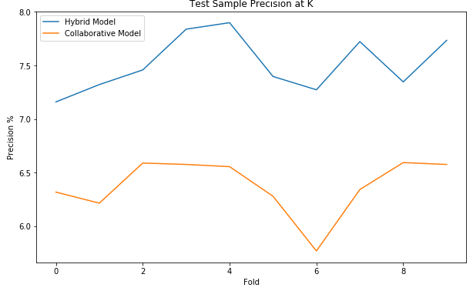
Light FM: Hybrid Approach
Incorporating item features boosted Precision at K from ~6.2% to ~7.5%

Slide 28
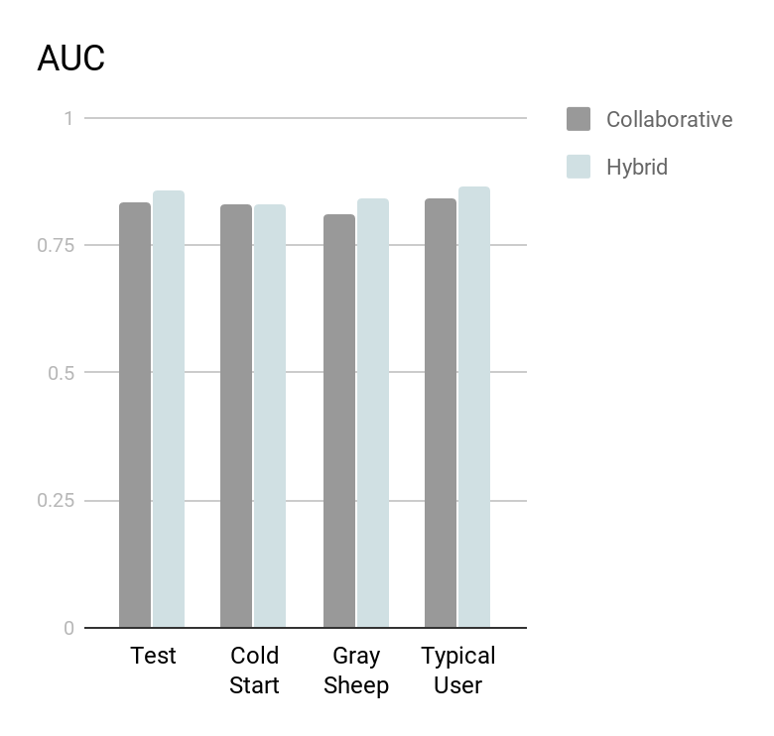
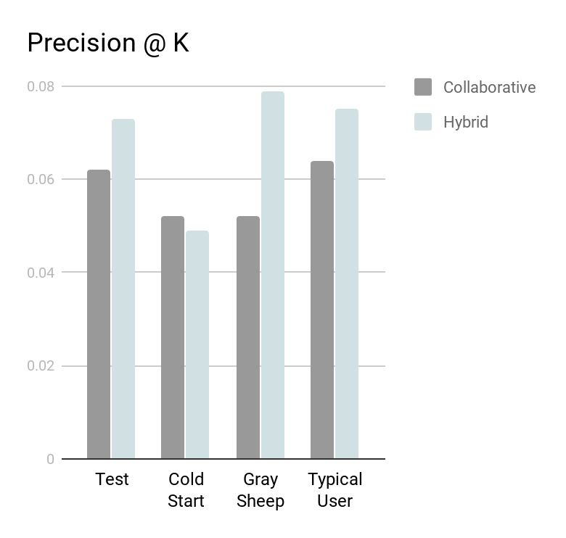
Performance on Segments

Slide 29
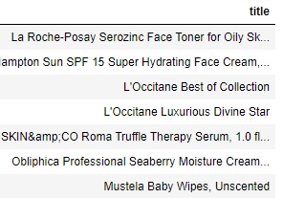
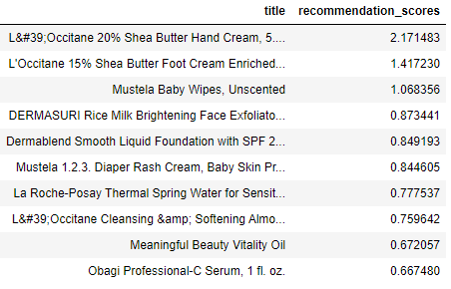
Light FM: Hybrid Approach
Example
Previous Purchases
Recommendations

Slide 30
Conclusion
By using a Hybrid model with collaborative and content based components, we saw a 25% improvement in precision at 5 compared to collaborative only model
We were able to gain insights from the data:
Sentiment polarity for text reviews
Aspect based sentiment analysis
Ideally we would continue to explore incorporating this into recommendations
Limitations:
Clustering customers based on text data from reviews became challenging due to sparsity of the matrix
Would benefit from more information like customer demographics
Data is limited to explicit feedback provided by reviews. Given more implicit data (repeat purchases, clicks, etc.) we could improve the efficacy of our model
Notes:
What could we have done better or more of?
Successes:
Created a hybrid model that improved precision at k by 25%
Written reviews are not a good starting point for a recommender system.

